Slide 1
Email Spam Detector A WEB APPLIcation
Presented By:
LakshyA MISHRA 21BCON322
ARYAN CHEETA 21BCON167
MUKESH KUMAR SONI 21BCON160
PRIYA FOUJDAR 21BCON298
Presented To: Ms. Sneha Kumari Department Of Computer Science & Engineering

Slide 2
Contents :
1. Introduction
2. Dataset Description
3. Preprocessing
4. Model Selection
5. Training and Evaluation
6. Results
7. Testing
8. Conclusion

Slide 3

Introduction
What is Spam?
Unsolicited, unwanted email, often sent in bulk.
Importance of Spam Detection:
Reduces clutter in inboxes.
Protects users from phishing and malware attacks.
Project Goal:
Develop an efficient spam detection system using machine learning.

Slide 4

Dataset Description
Source: Kaggle
Size: 5500 ROWS
Labels: HAM,SPAM

Slide 5
Preprocessing
Data Cleaning: Removal of HTML tags, special characters, etc.
Tokenization: Splitting text into words or tokens.
Normalization: Converting text to lowercase.
Stopwords Removal: Removing common words that carry little meaning.
Vectorization: Converting text data into numerical form (TF-IDF, word embeddings).

Slide 6
Model Selection
Algorithms Considered:
Naive Bayes
Random Forest
Neural Networks
Evaluation Metrics:
Accuracy, Precision, Recall, F1 Score

Slide 7
Training and Evaluation
Training-Validation Split:
80% Training, 20% Validation
Model Training:
Fit the selected model on the training data.
Evaluation:
Test the model on unseen data (test set).
Metrics Evaluation:
Accuracy, Precision, Recall, F1 Score

Slide 8

Results
Model Performance:
Accuracy: 97.1%
Precision: 100%

Slide 9
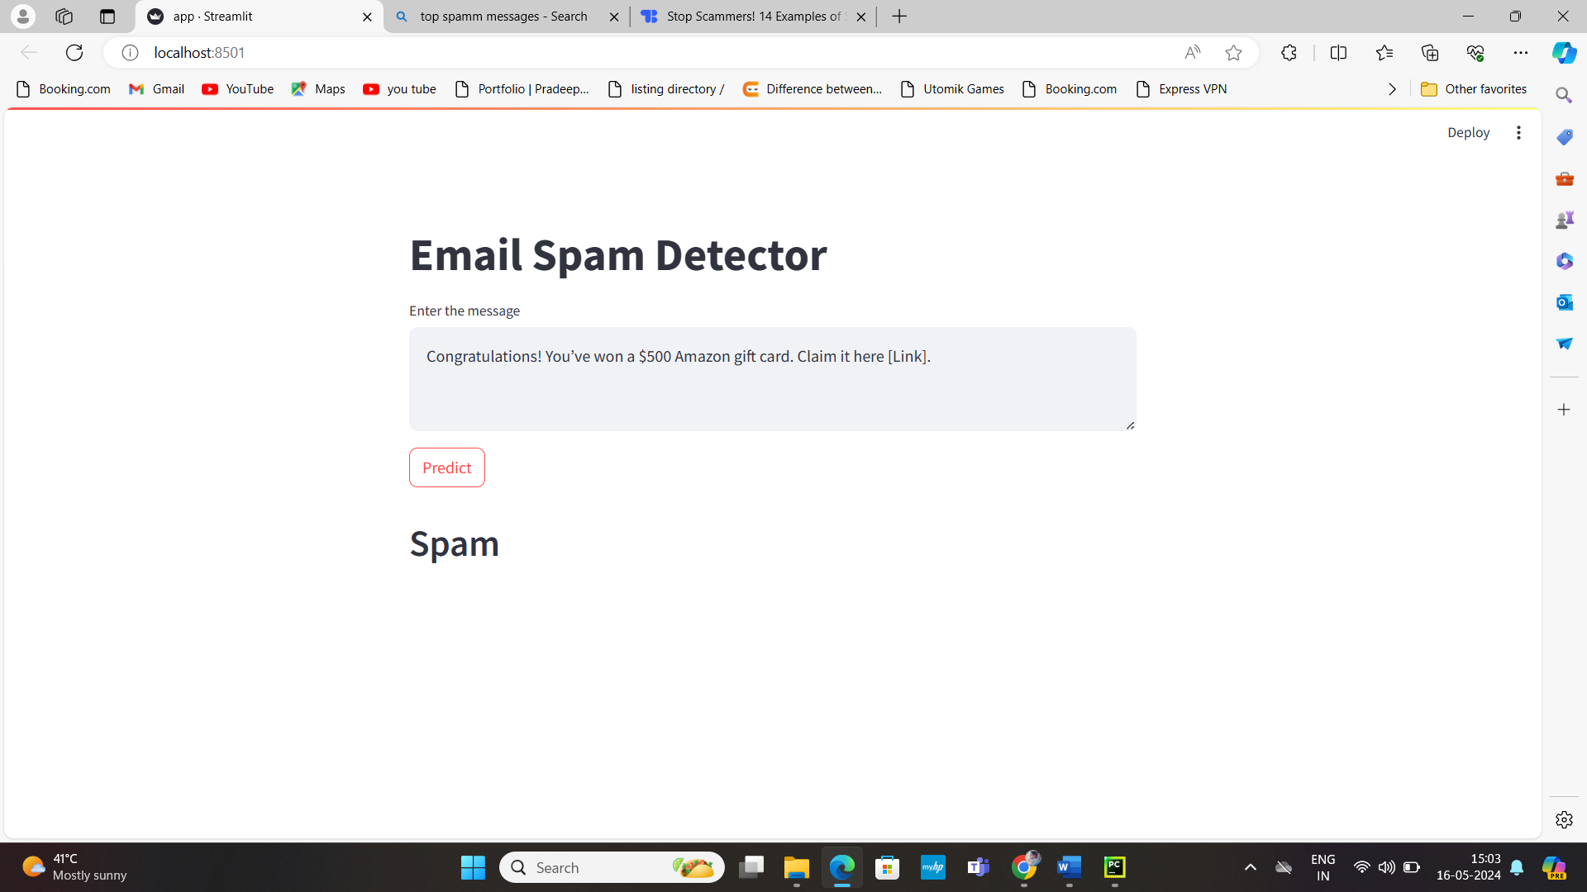
TESTING
Testing the Email Spam Detector to match the predicted results with actual results.

Slide 10
Conclusion
Key Takeaways:
Successfully developed a spam detection system.
Achieved 97.1% accuracy on the test set.
Impact:
Improving email user experience.
Enhancing cybersecurity measures.

Slide 11
THANK YOU

